Slide 1
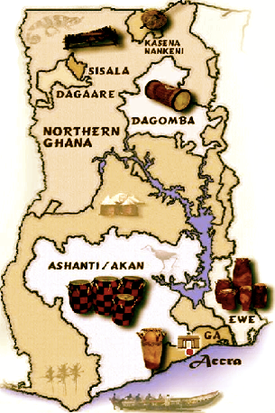
Traditional Music from Ghana
Educational
presentation
Colleen M. Haas

Slide 2
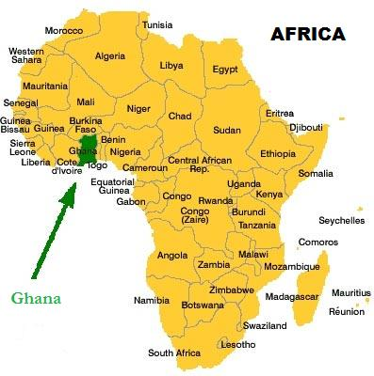
Ghana
Ghana is located in West Africa.
Its neighbors are Cote d’ Ivoire
to the west and Togo to
the east.
Societies began as one of the earliest
empires in West Africa.
Peoples moved southward, to the coast after its decline and the rise of the Mali empire.
Colonized by the British early - late 1800s “the gold Coast”
First African region to gain their independence from the British Crown. (1961-62)
Present day Ghana is the home of numerous ethnic groups, the most populous are the Akan, The Ewe, The Ga-Adangme, and the Dagara in the north.

Slide 3
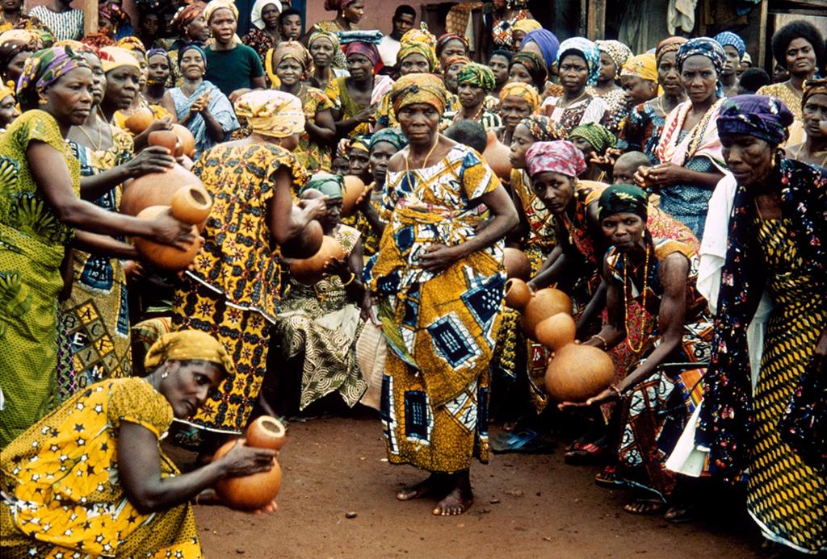
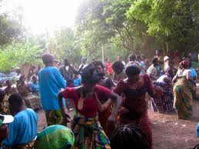
Occasions for Performance
Africans participate in a variety of musical occasions and groups or associations including …
Political activities
Life cycle events
Festivals
religious and secular
social/recreational
Because there are so many events and types of musical bands, many traditionally oriented musicians specialize in a particular type of music/performance tradition as a service to these events.

Slide 4
Musical principle #1: multipart textures
Much of traditional African music is performed by musical ensembles that perform multi part music on instruments and/or voice or both.
From a layering of parts there is a resultant effect
Music usually has 3-4 parts at a minimum sometimes many more layers.
Ex: flute piece with 2 or 3 parts, drums pieces can have up to 8 -11 layers.

Slide 5
Musical principle #1: multipart textures
Primary characteristic with multi part music is:
repetition,
When more musical interest or variety is needed it is done through layering by
adding or thinning the texture,
or by manipulating the tempo.

Slide 6
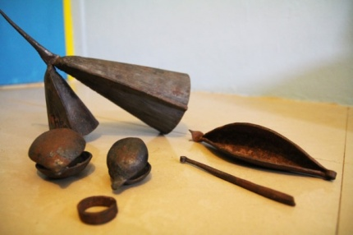
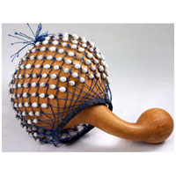
Musical principle #2: Timeline patterns
KEY instruments that help to organize the music performance
are usually hand held percussion instruments such as bells or
rattles.

Slide 7
Musical principle #2:
The prevalence of repetition and a musical structure of musical cycles
Traditional music is designed for bodily movement and communal participation
Short patterns are better for group participation.
Short patterns that layer upon one another, and repeat best serve the function of dance steps and their development.

Slide 8
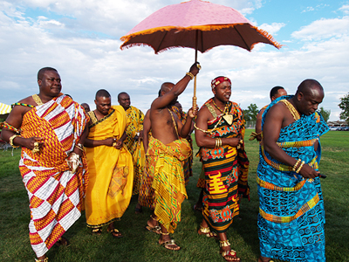
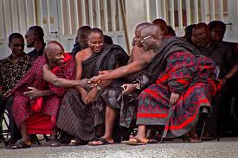
Case study 1: ethnic group: Ashanti
(Akan group)

Slide 9
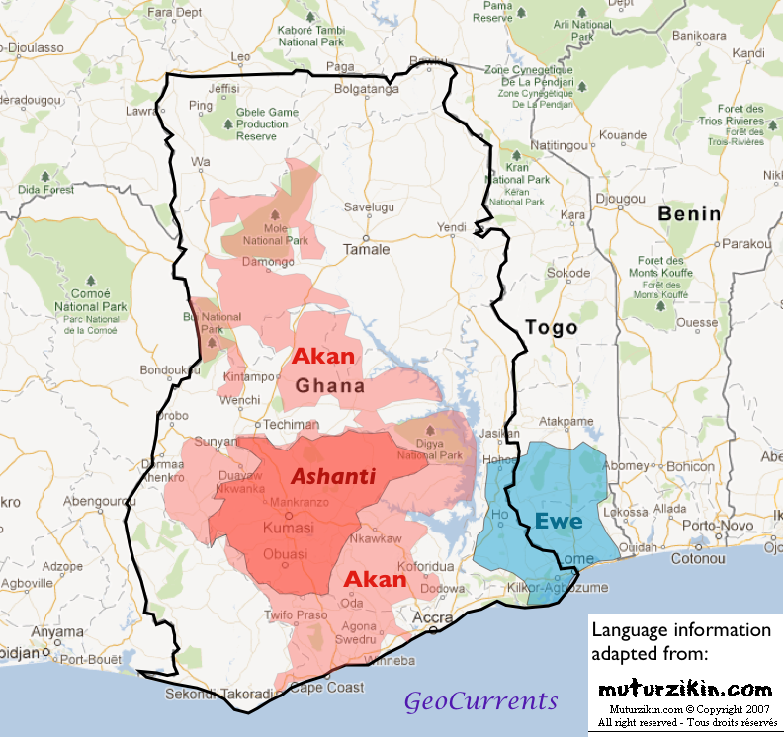
Ashanti (Akan)
Largest and most enduring ethnic group in Ghana
Still maintain many traditional practices
Have many elaborate
Civic events, Funerary rites and unique Entertainment Genres

Slide 10
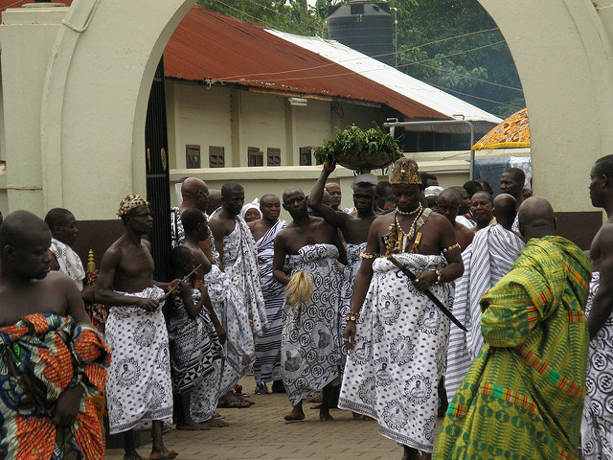
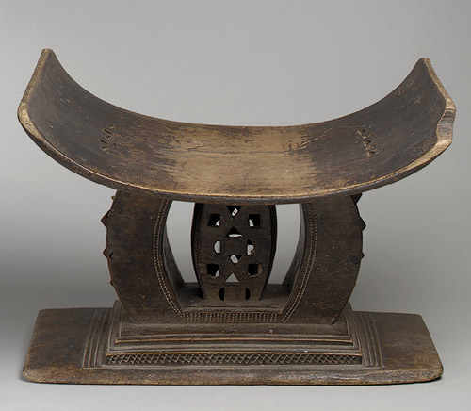
In the Ashanti region
Rituals and events
are held every six weeks
honoring the ancestors and
the line of Asante (Ashanti) kings.
Notes:
Image: Akwasidae celebration at Kumasi, Ashanti Region, Ghana, Courtesy imknowmadic2
http://kwekudee-tripdownmemorylane.blogspot.com/2014/09/the-great-akwasidae-festival-of-asante.html

Slide 11
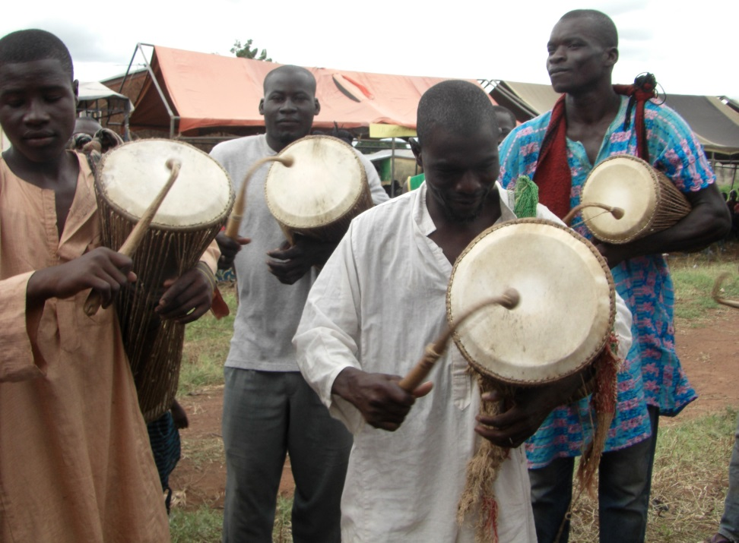
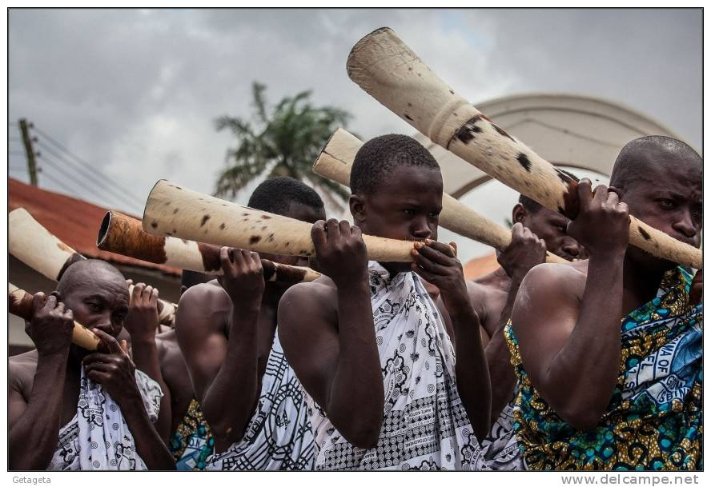
A gathering called Akom occurs where
drums are beaten &
horns are sounded to welcome everyone to the festival
This is done amidst dancing and merry making.
In the early hours of the morning the drums are resumed to symbolically rouse the dead kings and their elders (from their sleep) to also partake in
the festival.

Slide 12
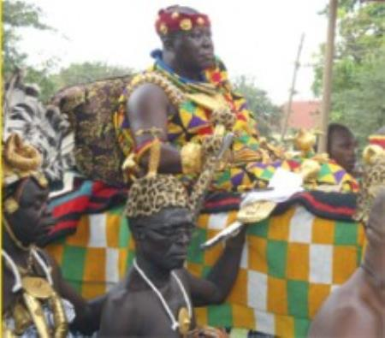
Earlier times in African had very
Complex political systems
In the Ashanti Region, Chiefs are still installed
But today have limited power
they are highly visible leaders
and have organized sectors of society
to continue their dominion
The Akan like to display their
Former Power and various
political positions
Uploaded on Feb 27, 2012 11:58 mins
The King of Juaben, borne aloft in a platform chair and proceeding to the durbar grounds. 40th Anniversary of His Installation.
https://www.youtube.com/watch?v=4mE4LaZ7MSE
Notes:
Instalation of a King
https://www.youtube.com/watch?v=4mE4LaZ7MSE

Slide 13
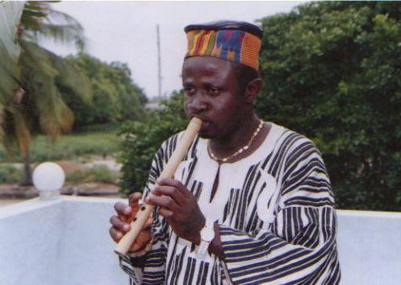
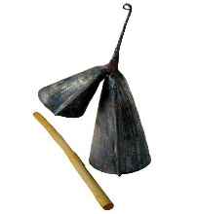
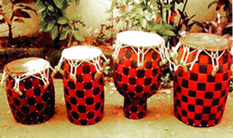
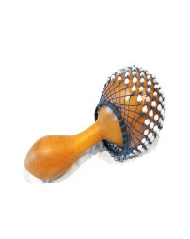
Instruments for Royal Music: Kete
Kete Drums
  Very specific to royal musicians
  Drums are used in royal processions
  Akan drums are covered with red & black striped cloth
  The cloth reminds them of the chief that has passed away
  Red cloth represents the blood that has been shed to defend the Akan heritage
Hand held percussion: bells & rattles
Sometimes Flutes are added:
The Atenteben
Notes:
Traditional kete drummers
https://www.youtube.com/watch?v=JeFtlcwuOZQ
Uploaded on Aug 8, 2008
At the National Culture Centre, Kumasi, Ghana.

Slide 14
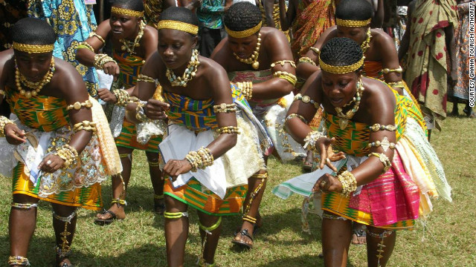
Royal Dancers
The dancers for Kete are highly trained, and the circumstances of their performance carry high stakes as they must not make a wrong move, or put on a mediocre performance.
Their dance steps and gestures both announce the arrival of kings and chiefs into various public gatherings, but the dancers also learn through symbolic dance movements to honor and praise their
acts and
attributes after the
chiefs arrive.
https://www.youtube.com/watch?v=JeFtlcwuOZQ
Uploaded on Aug 8, 2008 7:09 mins
At the National Culture Centre, Kumasi, Ghana.
Notes:
Videos Kete dances:
https://www.youtube.com/watch?v=ff7zvV2C54I

Slide 15
Videos
Kete - royal court music of Asante, Ghana Adaban, Abofoo, Dabrebua, Takyiman UMass Dartmouth Kekeli West African Drum and Dance Ensemble. Published on Nov 17, 2013
https://www.youtube.com/watch?v=FmTmU7Mjnnw
Kete dance
Display of Akan traditions
https://www.youtube.com/watch?v=KTQbkNnJs34
Recommended: youtube link, history of the Akan
https://www.youtube.com/watch?v=ru2Iv1O_G_0

Slide 16
History and culture resources
The 300 year old Asante Kingdom
Published on Sep 28, 2013
https://www.youtube.com/watch?v=4lXyh7Bg8Oo

Slide 17
Images courtesy of
(Music ensemble) the Group Anokye Agofomma
Roots A Community Consortsium
http://africanmusicnites.org/category/ghanaian-music/
"Guests greeting one another at a funeral in Kumasi"
Kwekudee facebook page
http://kwekudee-tripdownmemorylane.blogspot.com/2014/09/unique-and-culturally-flamboyant.html
Kete Ensemble From Ghana, Grinnell College Musical Instrument Collection
http://omeka1.grinnell.edu/MusicalInstruments/exhibits/show/ens/kete

